Slide 1
Breaking the Cycle
A tool to predict hospital readmissions
Sheena Sharma

Slide 2

Problem:
Readmissions are very costly.
Goal:
To predicting factors of hospital readmissions
after heart failure
Notes:
With better understanding of readmission rates per state and the biggets predictors of readmission rates (cheap fixes, expensive fixes) can help insurance companies choose what state to target next.

Slide 3

Heart Failure - biggest predictor of readmissions
Data Wrangling/Cleaning
Data Exploration
-6 unique Medicare data sets
-Spending per claim, infection rates, patient satisfaction

Slide 4
Lower readmissions in rural states
Risk Standardized Readmission Rates by State

Slide 5
Choosing a Random Forest Regression
Feature Selection/
Engineering
Model
Selection/
Training
Recursive Feature Elimination
Linear Regression
Ridge Regression
Support Vector Regression
Random Forest Regression

Slide 6
www.predictingreadmissions.com

Slide 7
Relatively low error across states
Testing and Validation

Slide 8
Breaking the Cycle
1% reduction in readmissions rate = $15-16mil /year
Strategic Insight: Partnering with states that have low readmissions and more easily improvable factors for readmissions

Slide 9

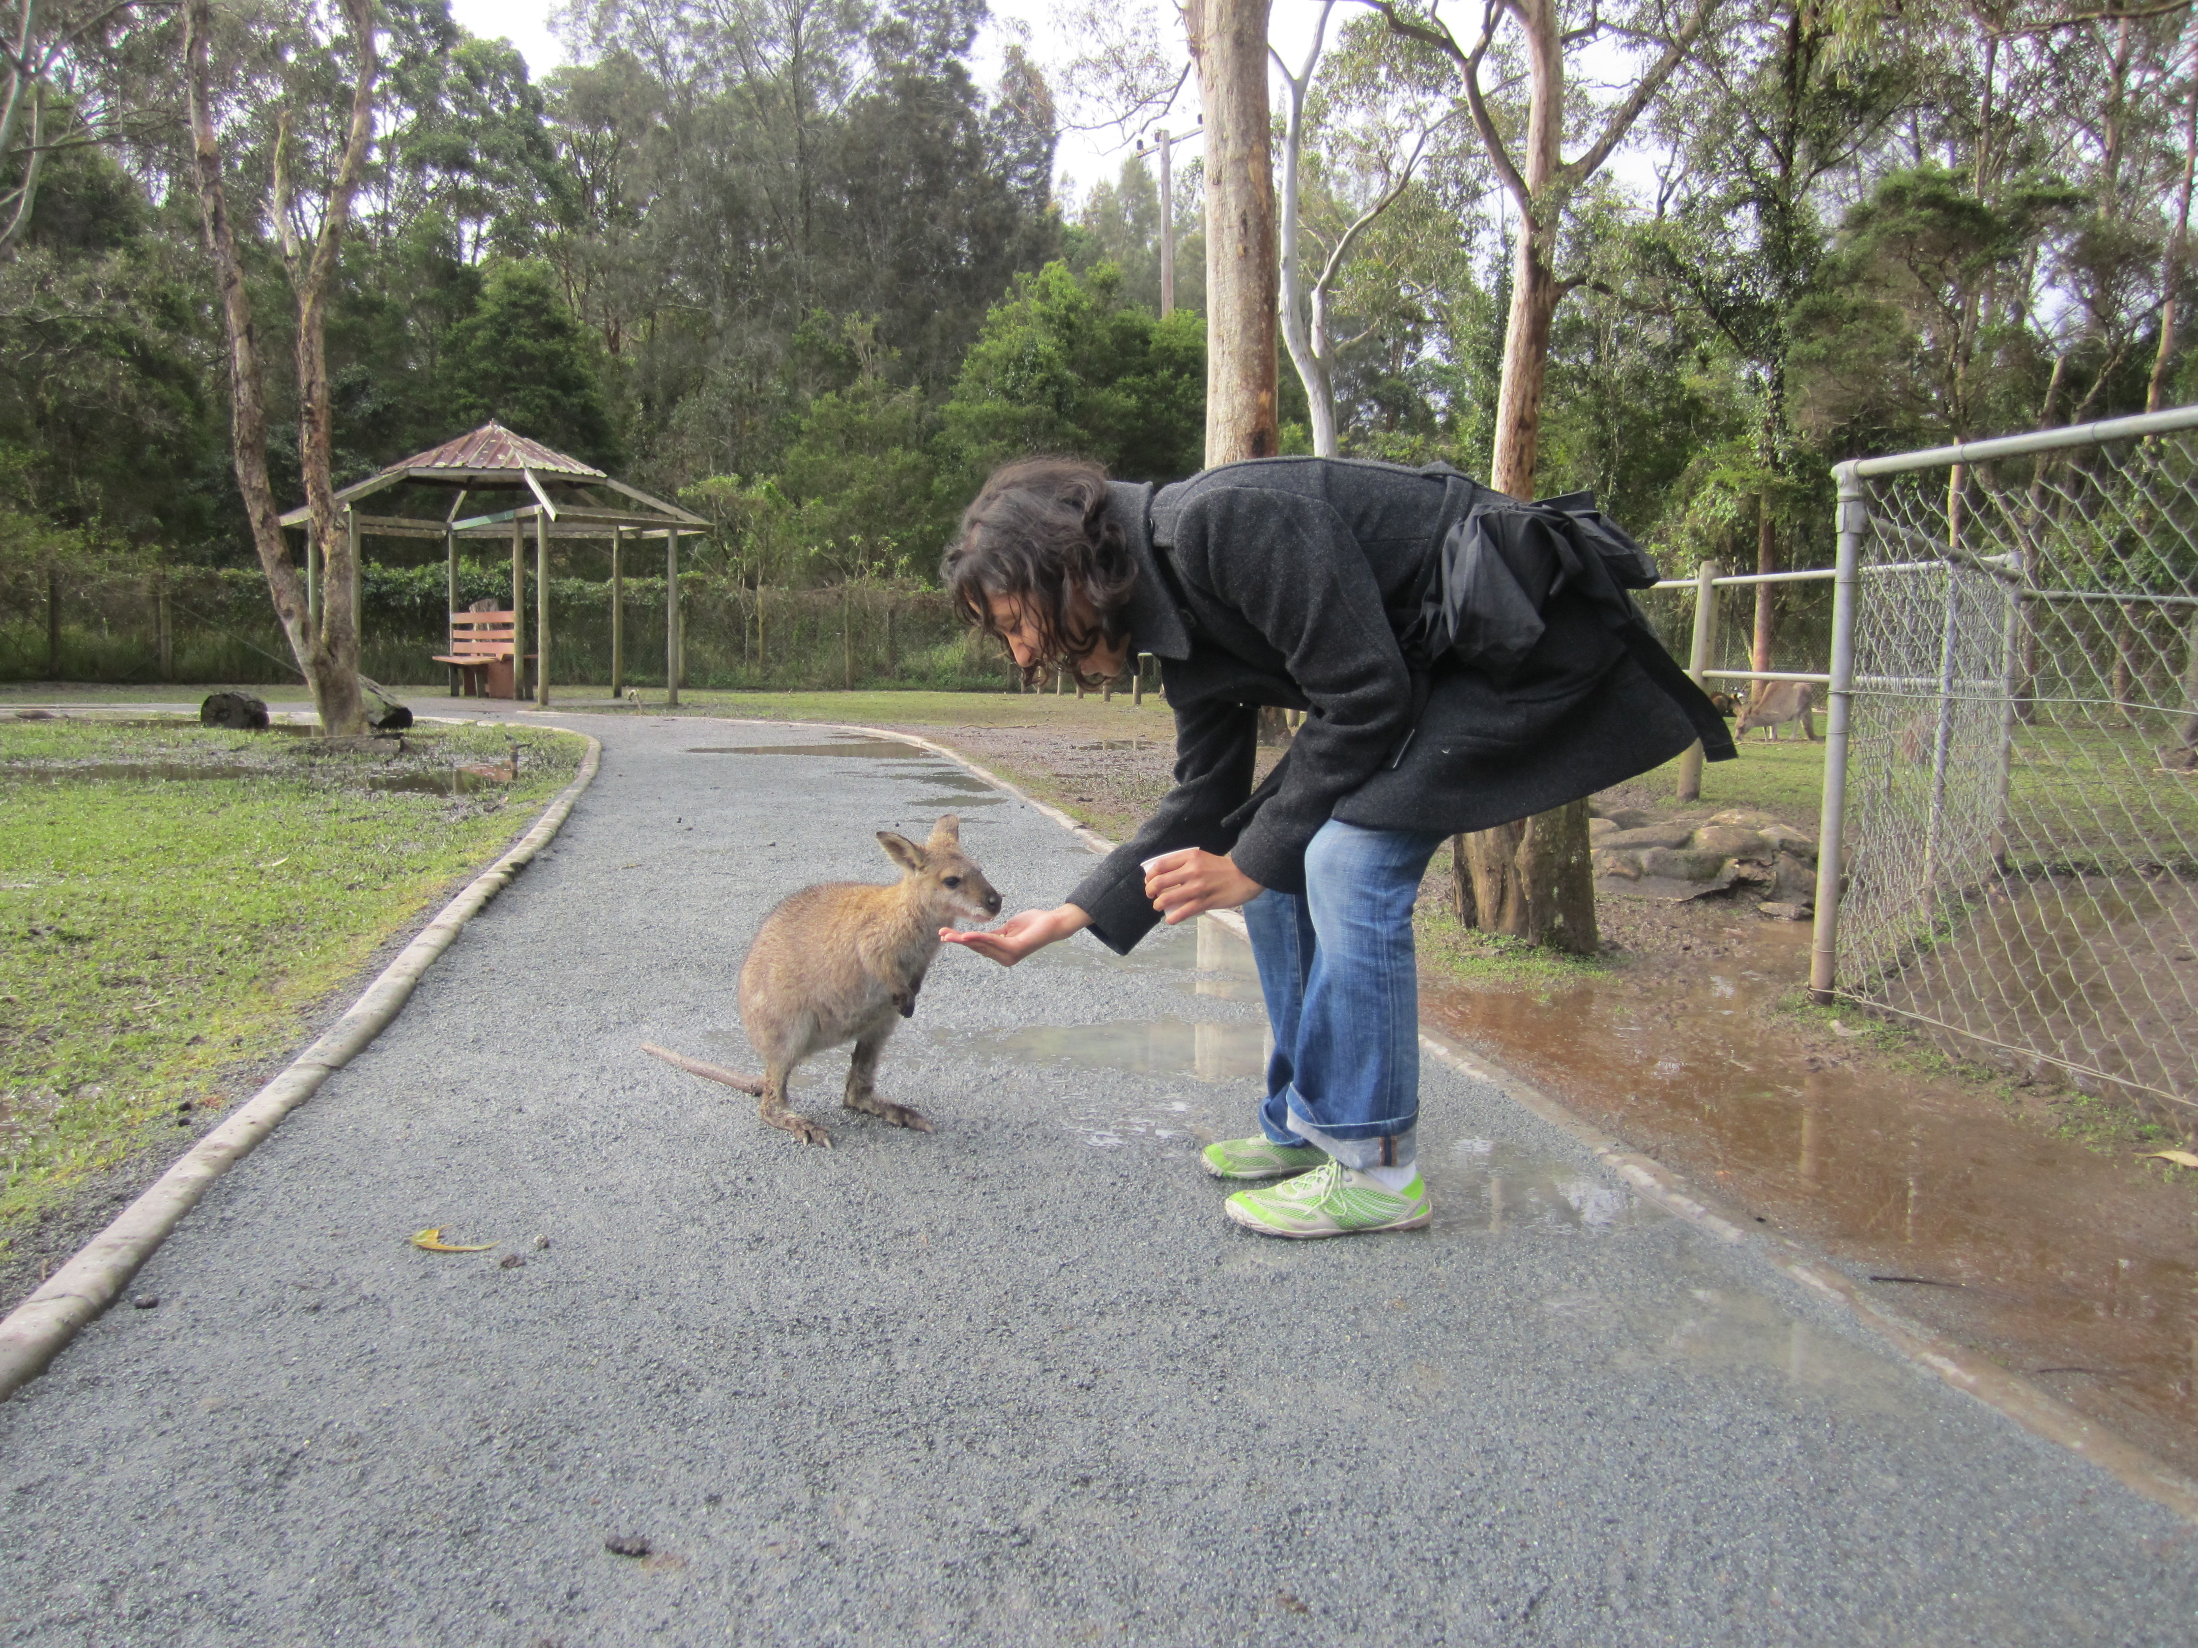


Not sure how to get down…

Slide 10
States with less data have lower error

Slide 11
R² of Important Features
Important features were selected by a recursive elimination search – coefficients assigned to features (greedy algorithm)
Recursive Feature Elimination
Correlations of important features and target (Ex. AR)

Slide 12
Small states have lower percent error

Slide 13
Output:

Slide 14
Input:

